Slide 1
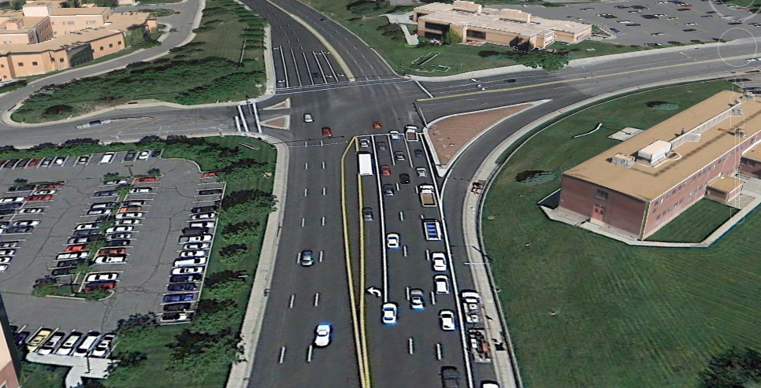
Mario Capecchi Intersection
Mike Eixenberger, Daniel Stecki, Wade Stinson,
Larvin Pollock and Landon Dixon

Slide 2
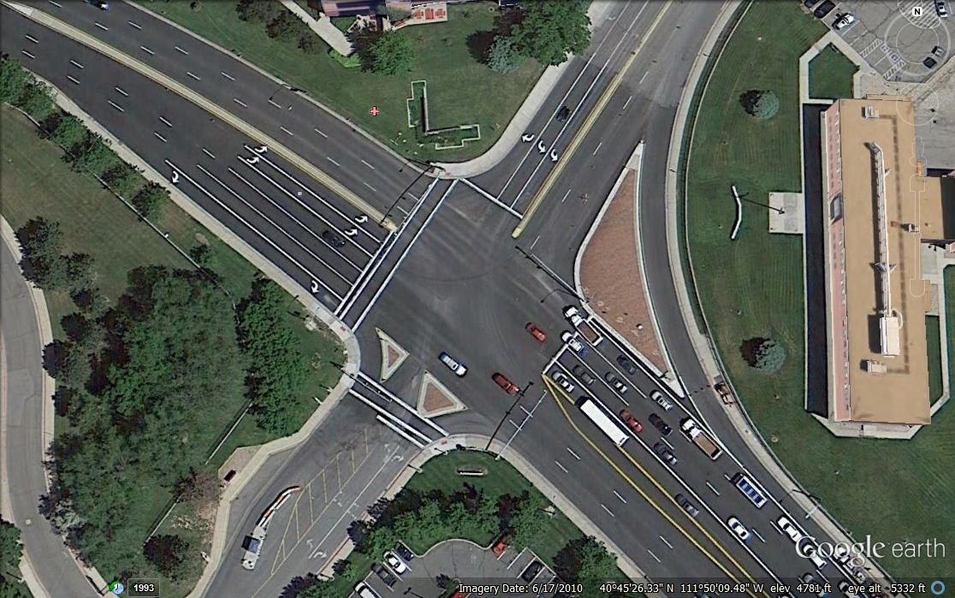
Mario Capecchi & Foothill Drive Intersection

Slide 3
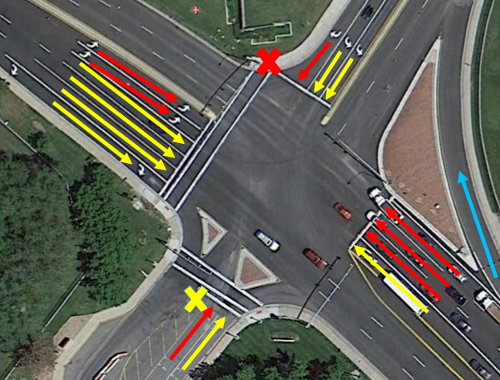
Mario Capecchi & Foothill Drive Intersection

Slide 4
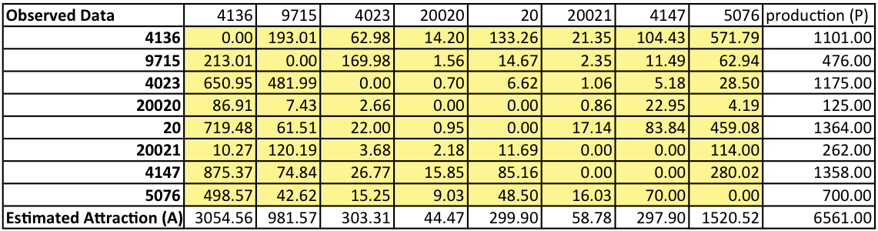
Collected OD Matrix

Slide 5
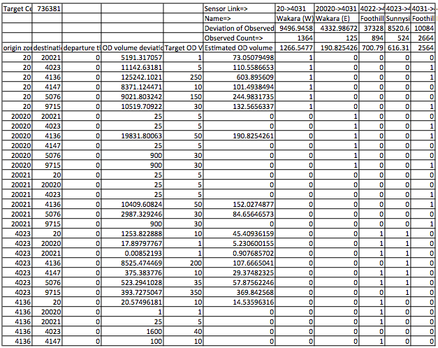
Optimized OD Matrix

Slide 6
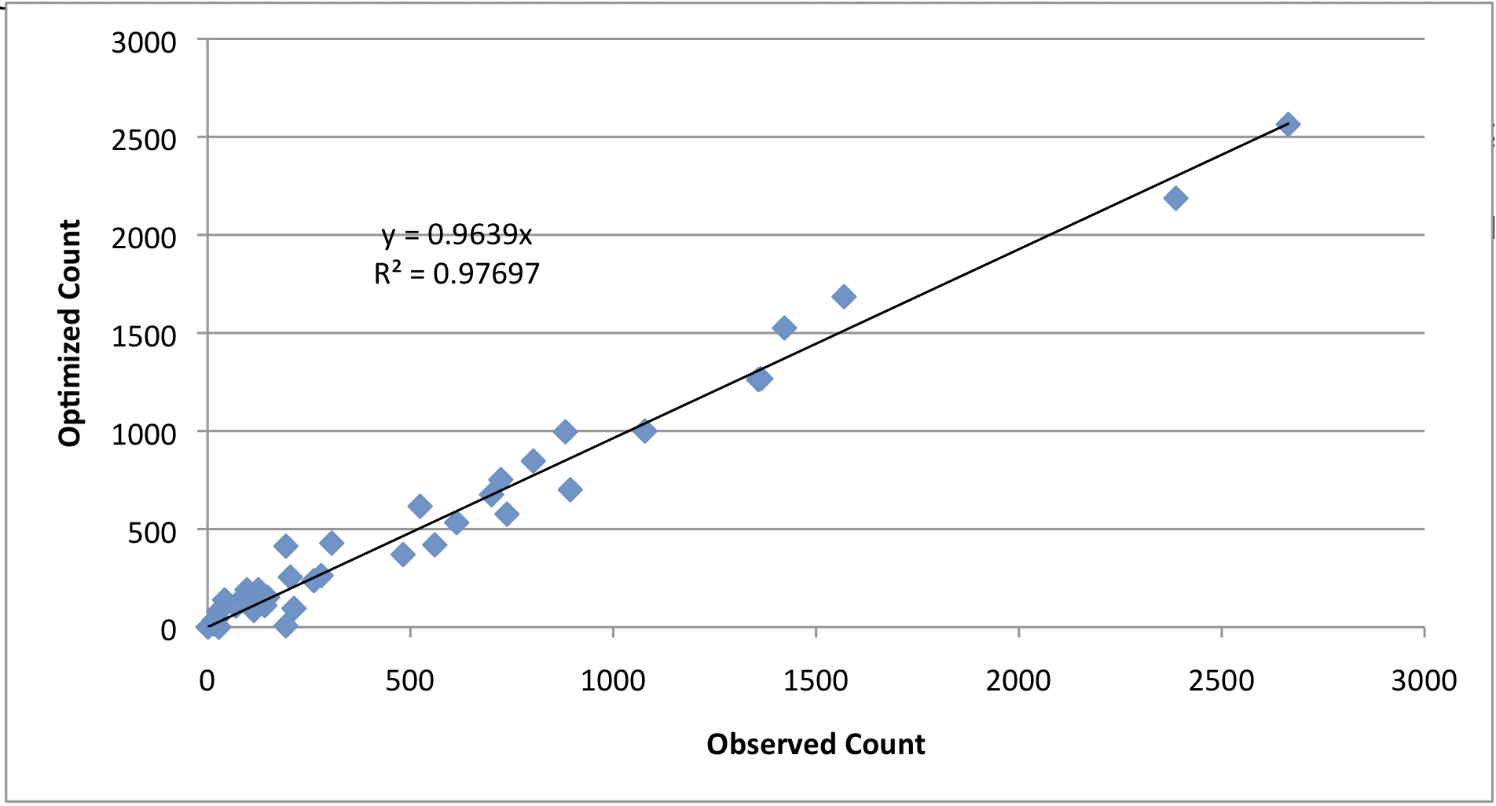
Optimized OD Matrix

Slide 7
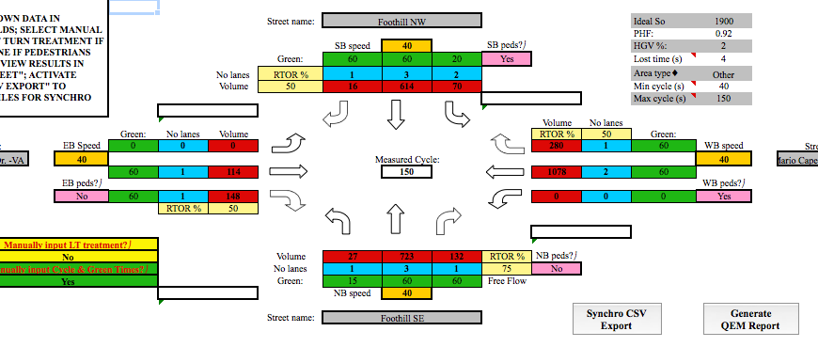
QEM and Synchro Input

Slide 8
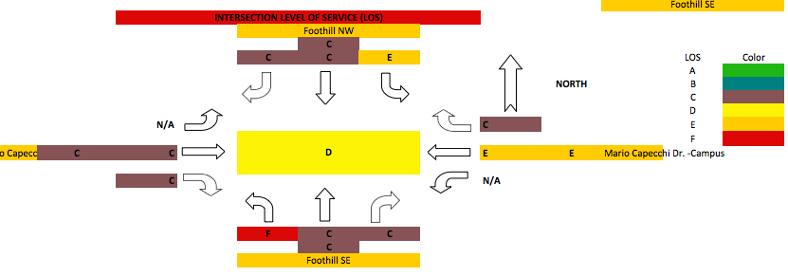
QEM and Synchro Input

Slide 9
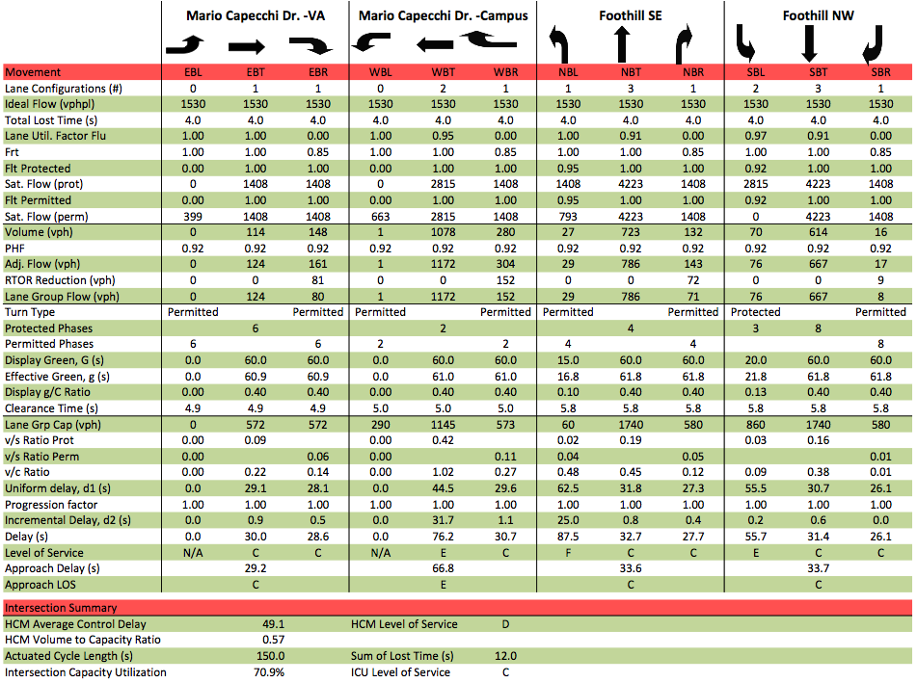
Mario Capecchi & Foothill Drive QEM Report

Slide 10
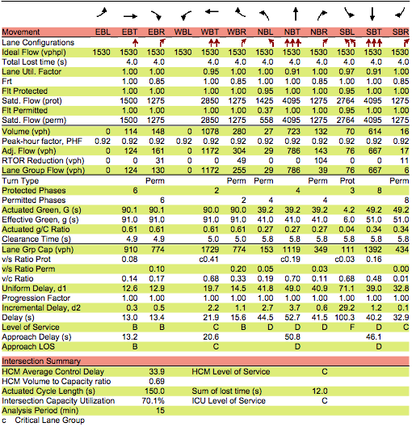
Mario Capecchi & Foothill Drive Synchro Report

Slide 11
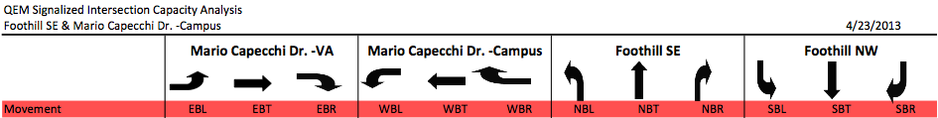
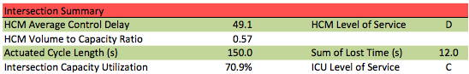
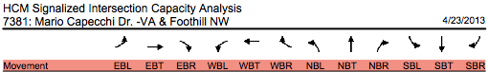
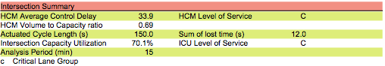
QEM VS Synchro Report
D
49.1
C
33.9
C
C

Slide 12
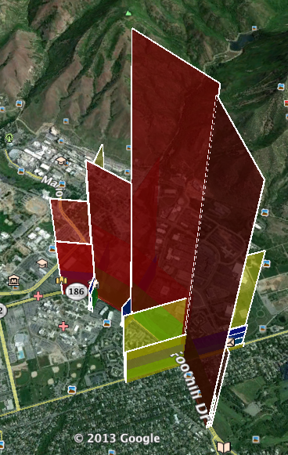
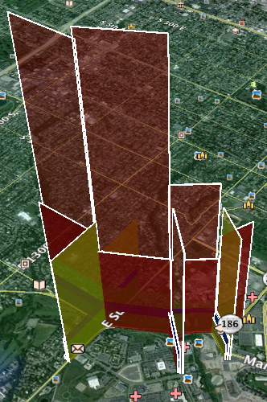
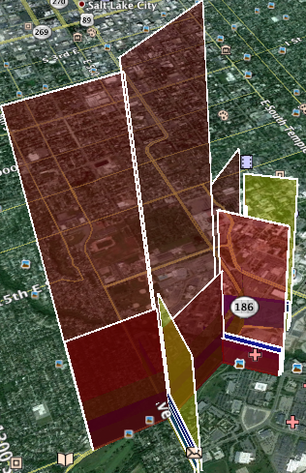
Traffic Link Visualization

Slide 13
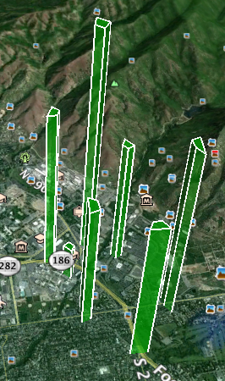
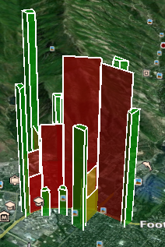
Zone Visualization

Slide 14
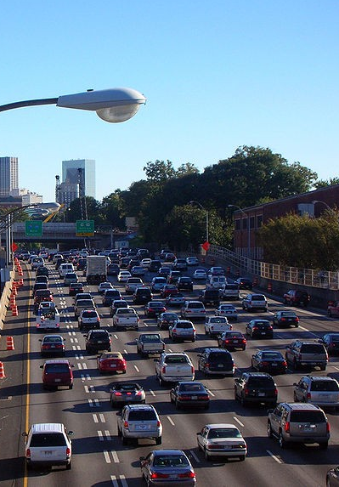
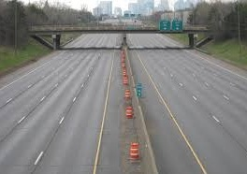
Suggestions and Possible Solutions

Slide 15
Suggestions and Possible Solutions
Include a protected left turn on Foothill SE
Additional Link to relieve Mario Capecchi.
Care to avoid Bräss Paradox
Widen the road way to allow for additional lanes
Include another turn lane where the empty median space exists.

Slide 16
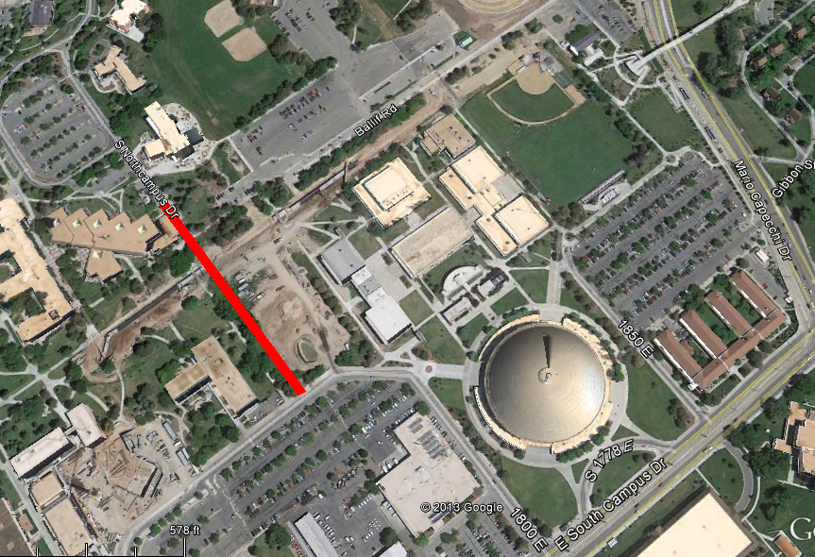
Suggestions and Possible Solutions
Link between Central Campus Drive and 1800 E.
Area already under construction
Only 0.15 miles

Slide 17
Suggestions and Possible Solutions
Our final recommendation to reduce congestion on the Mario Capecchi intersection is reduce the amount of traffic exiting the University of Utah using this intersection. This could be achieved by adding an additional link between Central Campus Drive and 1800 E. The would alleviate the traffic on this intersection.
However, the best system wide solution would be to increase the green time on Wakara Way and Sunnyside. During peak hours, the left turn lane from Mario Capecchi to Foothill backs up and reduces the number of vehicles that can pass though the intersection regardless of green time. Increasing the green time on the south bound direction for both Sunnyside and Wakara would improve the traffic congestion on Mario Capecchi. Furthermore, this change would allow traffic to flow based on the left turn green time, rather than the queuing time and length from the upstream intersections.

Slide 18
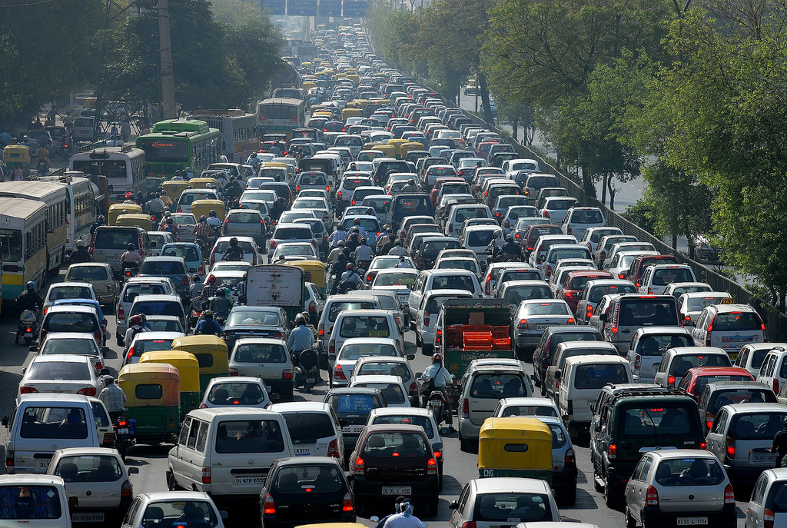
Conclusion

